Slide 1
Producing Light-Curves for Accreting T-Tauri Stars in the GAPlanetS Survey
Julio Morales
Advisor: Prof. Kate Follette

Slide 2
1. Giant cloud of gas and dust in interstellar space.
2. Clumps begin to form within the cloud
3. Dense cores, precursors to stars, form within clumps.
6. Planets form from the disks, forming a solar system.
4. Cores condense into young stars surrounded by dusty disks.
Credit: Bill Saxton, NRAO/AUI/NSF

Slide 4
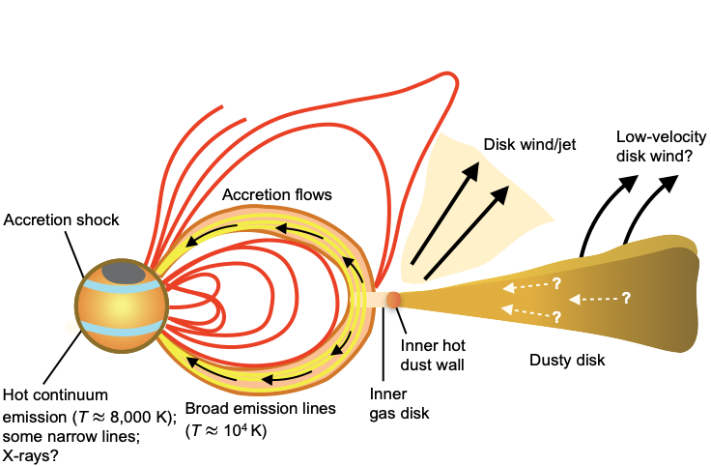
Magnetospheric Accretion
Credit: Hartmann et al. (2016)
Credit: Hartmann et al. (2016)

Slide 5
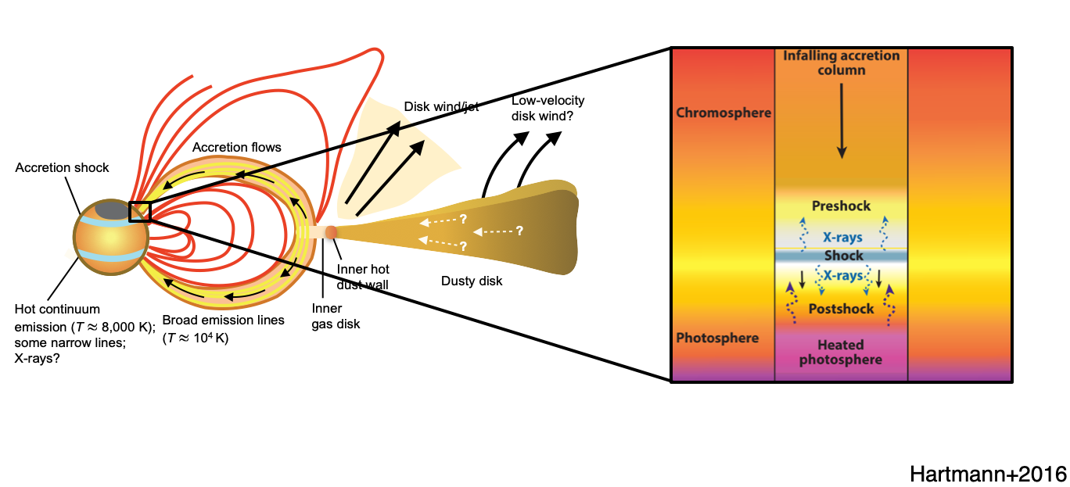
Magnetospheric Accretion
Credit: Hartmann et al. (2016)

Slide 6
Light-Curves
Credit: Cody et al. (2014)

Slide 7
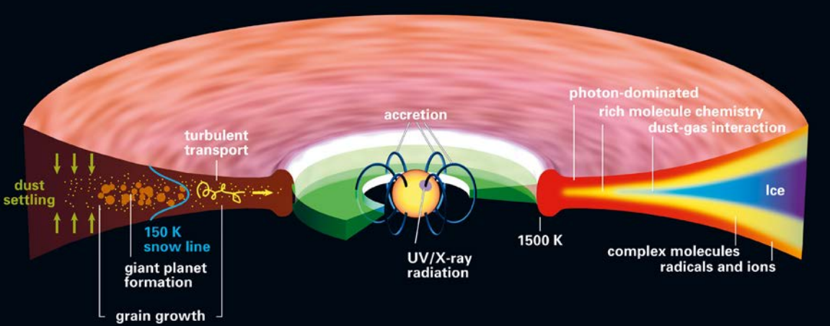
Rapid Changing Disk Structure
Credit: Dmitry et al. (2020)
Credit: Cody et al. (2014)

Slide 8
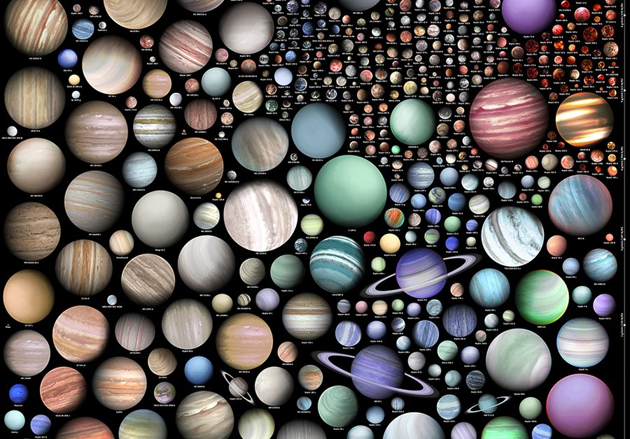
Credit: Cody et al. (2014)

Slide 9
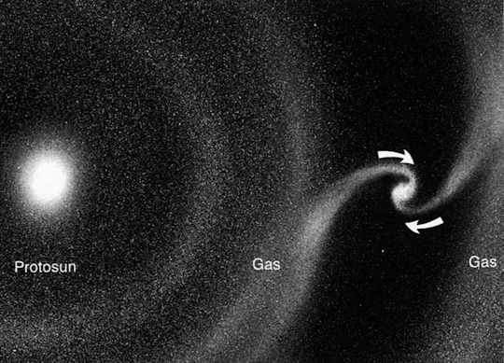
Transitional Disks

Slide 10
Transitional Disks

Slide 11
Transitional Disks
(6-8) Stellar Radii

Slide 12
Transitional Disks
(6-8) Stellar Radii
(50-100) AU

Slide 13
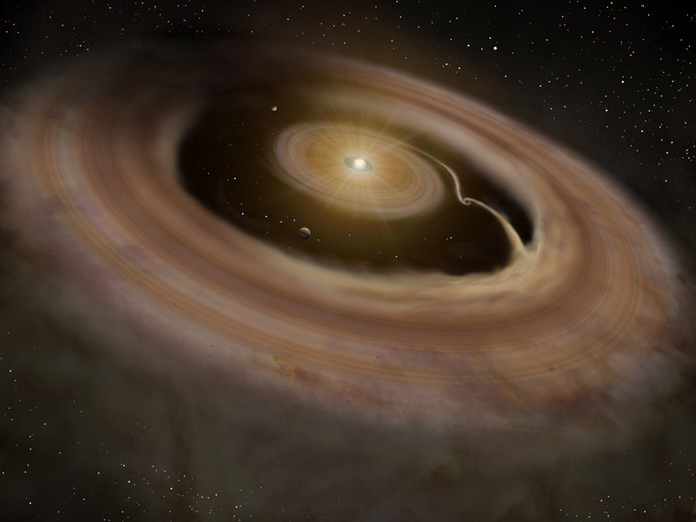
Accretion Tongues

Slide 14
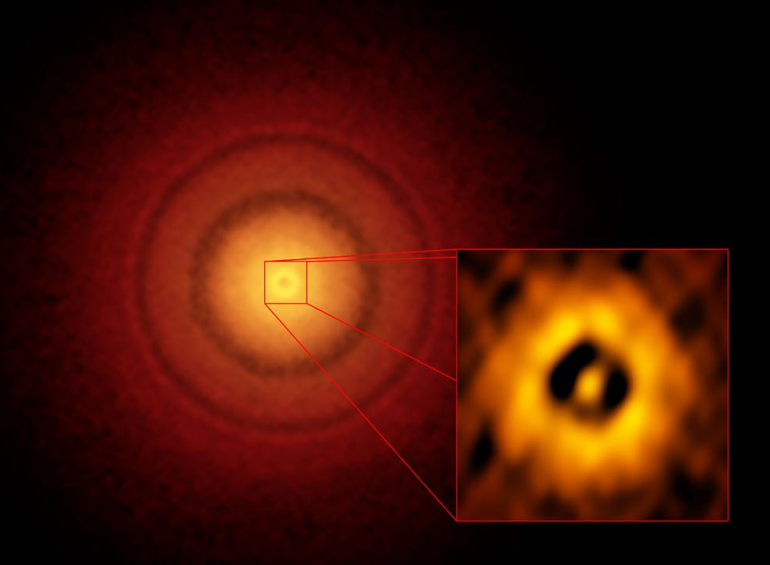
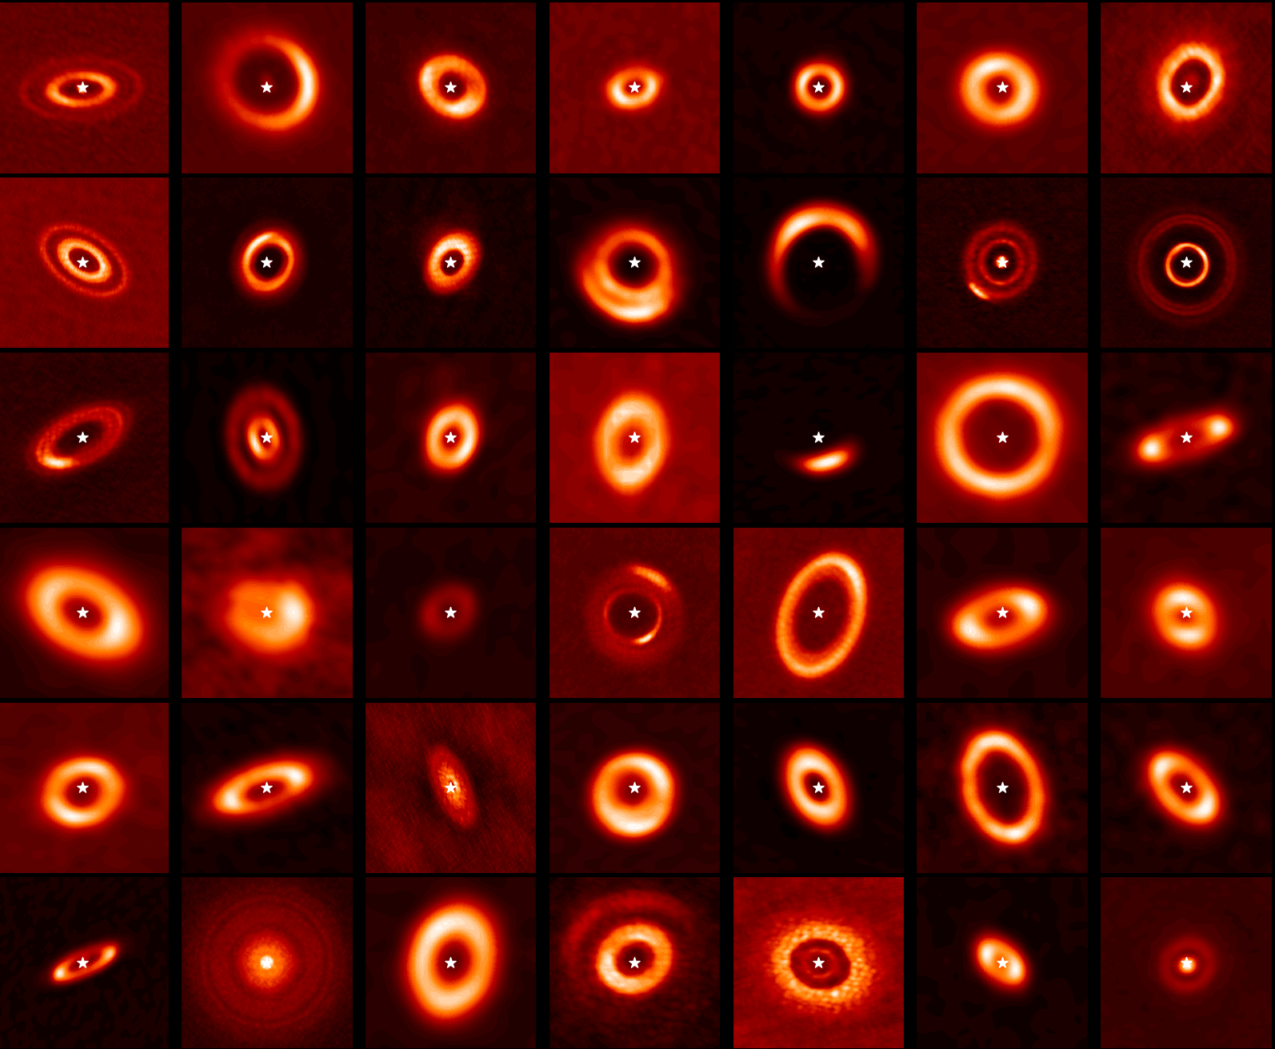
The GAPlanetS Survey

Slide 15
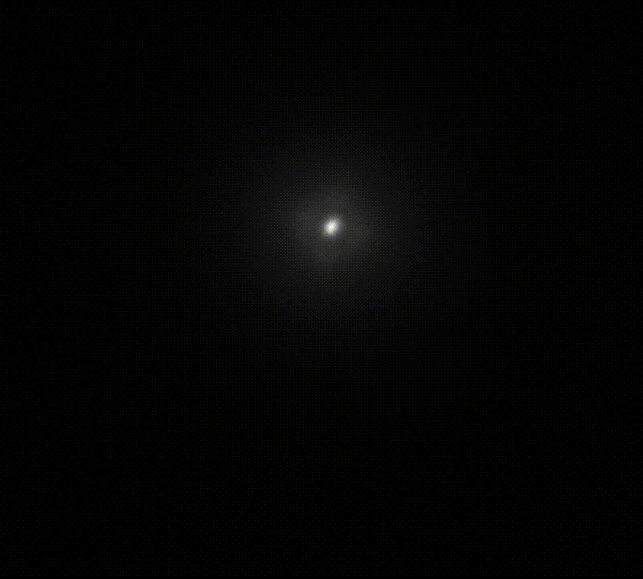
“Mysterious thing time...powerful...but when meddled with...dangerous.” - Professor Dumbledore

Slide 16
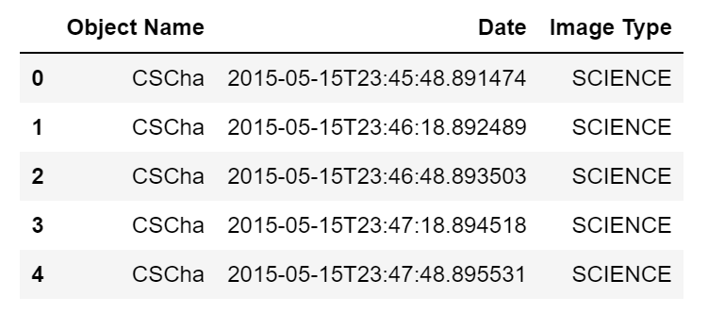
Timestamps

Slide 17
DAOStarFinder Tool

Slide 18
DAOStarFinder Tool

Slide 19
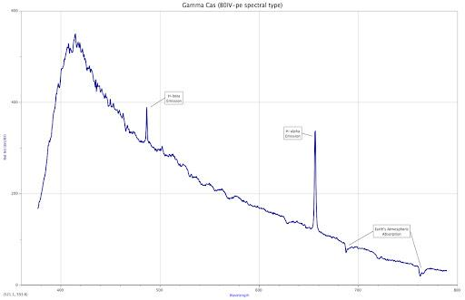
Line vs. Continuum Emission
H Alpha Emission
Continuum Emission

Slide 20
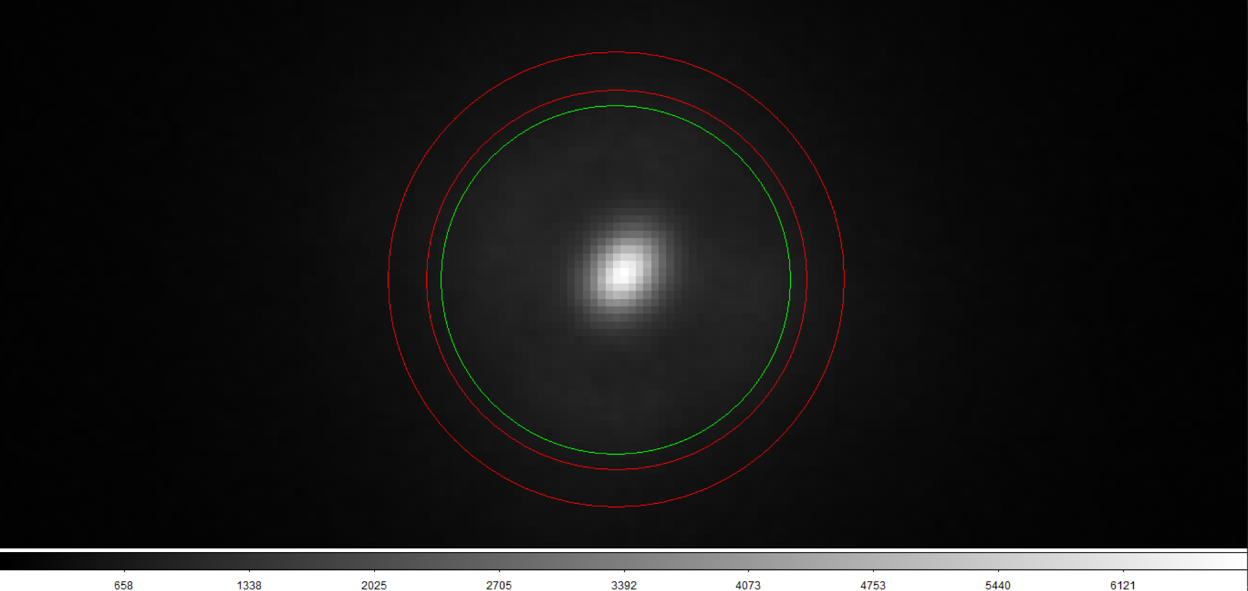
Aperture Photometry

Slide 21
Aperture Photometry
Aperture circle (count flux from star)

Slide 22
Aperture Photometry
Inner sky circle (local noise)
Aperture circle (count flux from star)

Slide 23
Aperture Photometry
Inner sky circle (local noise)
Aperture circle (count flux from star)
Outer sky circle (local noise)

Slide 24
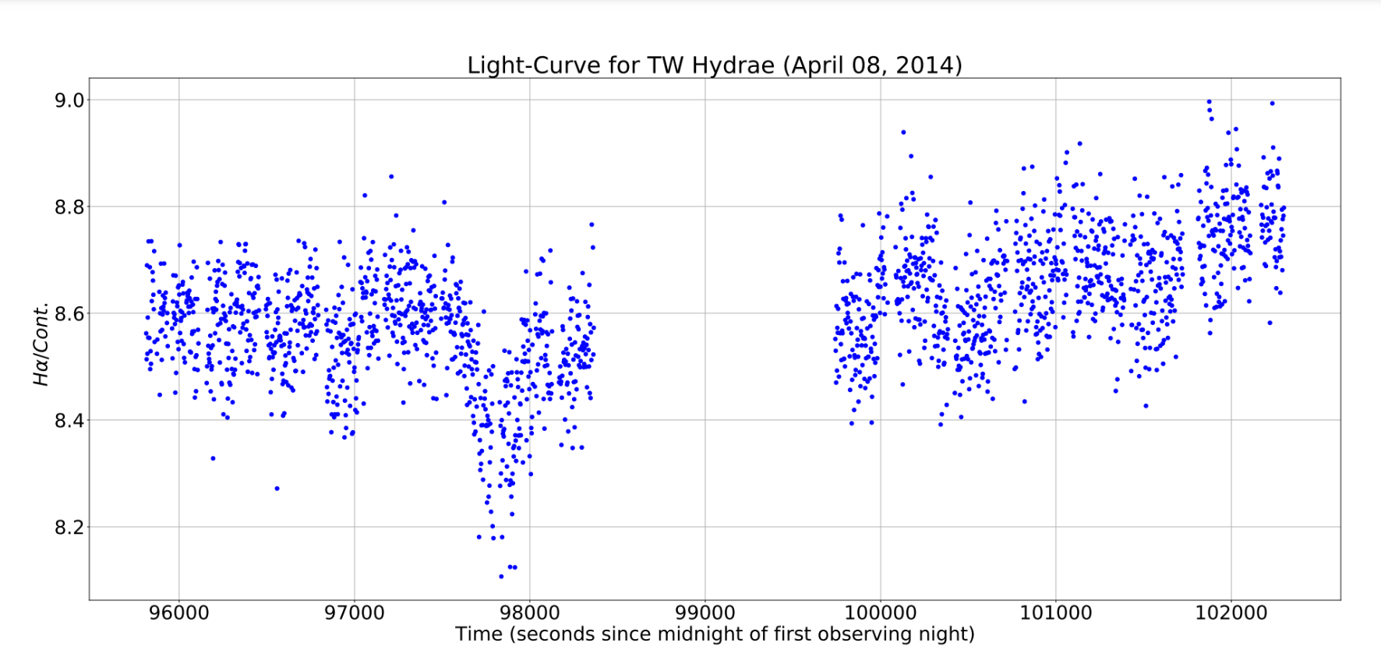

Slide 25
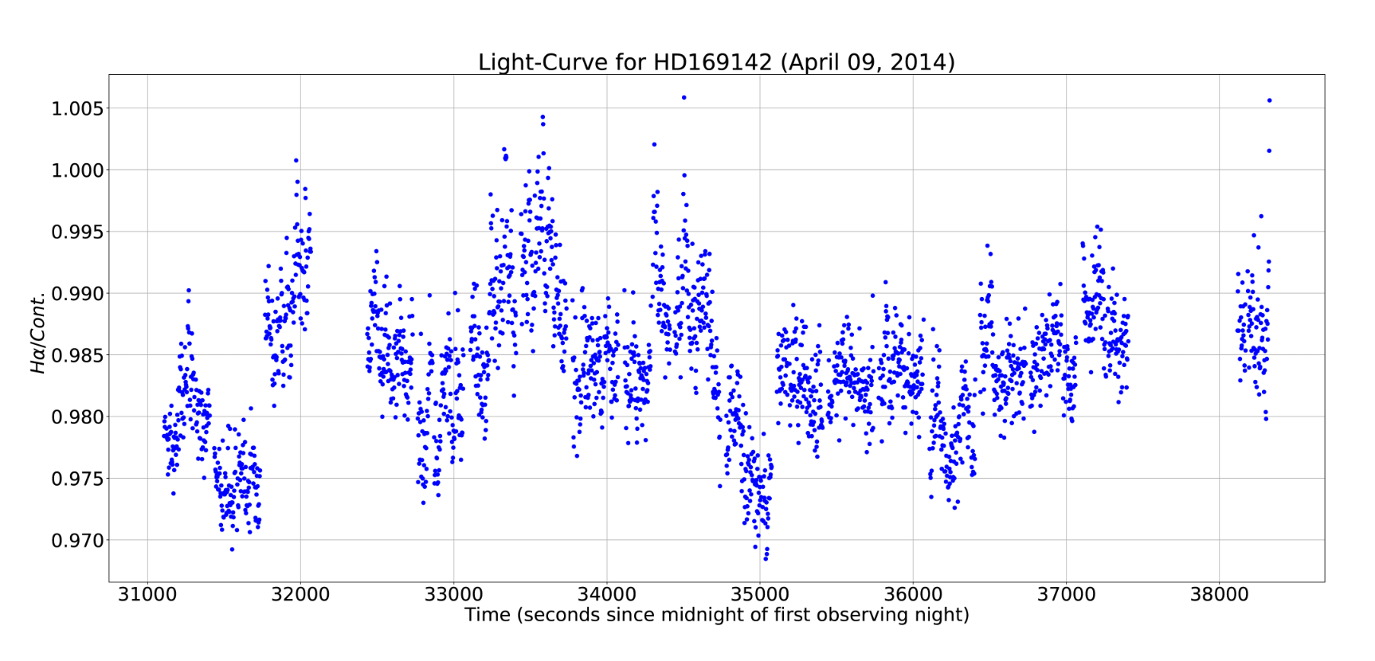

Slide 26
Next Steps
Produce light-curves for the rest in the survey
Classify light-curves based on morphology
Search for indicators of accretion variability

